Slide 1
PROJECT TITLE: Conversational Image Recognition Chatbot
CSE7101- Capstone Project
Review-1
Batch Number: ISE_15
Under the Supervision of,
Mr. Jaikumar B
Associate Professor
School of Computer Science and Engineering
Presidency University
Roll Number | Student Name
20221ISE0046 | K KEERTHI
20221ISE0085 | ADITI N
20221ISE0055 | RAVI RAJ P MATH
Name of the Program: Information Science and Engineering
Name of the HoD: Dr. Zafar Ali Khan N
Name of the Program Project Coordinator: Ms. Suma N G
Name of the School Project Coordinators: Dr. Sampath A K , Dr. Geetha A

Slide 2
Problem Statement Number:
Organization: Bharat Electronics Limited (BEL)
Category (Hardware / Software / Both): Software
Problem Description: Ever since the advent of AI and computer vision, modeling conversations has remained a challenge—especially when combining natural language processing (NLP) and image recognition. While popular chatbots like Apple’s Siri, Google Assistant, and Microsoft’s Cortana excel at language-based interactions, they lack advanced visual understanding. This project focuses on developing a deep learning–based conversational chatbot capable of recognizing objects in images uploaded by users and engaging in relevant, context-aware dialogue about them. The chatbot will not only detect objects but also answer questions regarding the image with grammatically correct and lexically precise responses, enhancing user experience in areas such as automation, accessibility, and interactive learning.

Slide 3
Content (continuation)..
Problem Statement
Objectives
Background and Related work for title Selection
Analysis of Problem Statement
Innovation or Novel Contributions
Git-hub Link
Timeline of the Project
References

Slide 4
Problem Statement and Objectives:
.
Problem Statement
Currently, most chatbots excel at text or voice interactions but cannot effectively understand or reason about images. There is a need for a conversational chatbot that can:
Identify and recognize objects in images uploaded by users.
Provide accurate, context-aware, and grammatically correct answers to questions about the image.
Maintain smooth, human-like conversational flow, while leveraging robust datasets to ensure high precision and recall.
Objectives:
Build an image-based conversational chatbot that can perform object detection, captioning, and visual question answering (VQA).
Use YOLOv8 for object detection, trained on the COCO dataset.
Integrate BLIP models to handle image captioning and VQA tasks.
Enable natural conversation using a large language model (e.g., LLaMA-2 or GPT).
Deploy the chatbot via Gradio to provide a user-friendly web interface.
Ensure responses are lexically rich and grammatically correct.
Measure performance using precision, recall, and user satisfaction metrics.

Slide 5
Background and Related work for title Selection
Datasets Used:
COCO, Pascal VOC, ImageNet, SUN – widely used benchmarks for object detection, image classification, and captioning.
Existing Systems:
Voice Assistants (Siri, Google Assistant): Good at natural conversation, but cannot understand or reason about images.
YOLO: Fast and accurate for real-time object detection, yet it doesn’t support dialogue.
BLIP / CLIP: Can generate captions and answer visual questions, but don’t handle multi-turn conversations.
Identified Gap:
Currently, there’s no single system that combines image recognition, captioning, VQA, and interactive conversation.
Our project aims to fill this gap by creating a unified chatbot that can process images and converse naturally.

Slide 6
Analysis of Problem Statement (contd...)
Feasibility:
Using pretrained models like YOLOv8, BLIP, and LLaMA-2 greatly reduces the need for building models from scratch.
Cloud platforms such as Google Colab make it easy to prototype, test, and iterate quickly.
Challenges:
Integrating computer vision tasks (object detection, captioning, VQA) with NLP-based conversation smoothly.
Maintaining real-time performance for processing images and generating text responses.
Ensuring the chatbot responds in a natural, human-like conversational manner.
Scope:
Prototype will be at an academic level, demonstrating an end-to-end multimodal conversational agent.
The system can be extended to real-world applications like e-commerce, healthcare, surveillance, or assisting visually impaired users.

Slide 7
Innovation / Novel Contributions:
End-to-End Multimodal Pipeline:
Integrates object detection (YOLOv8), image captioning and VQA (BLIP / BLIP-2), and a conversational LLM (LLaMA-2 / GPT) into a single unified system.
Dynamic Context Handling:
The chatbot remembers previously detected objects, allowing it to answer follow-up questions accurately and contextually.
Language Refinement Module:
Ensures responses are polished, fluent, and human-like, improving overall conversational quality.
Interactive Web Demo (Gradio):
Provides a cloud-based, user-friendly interface for real-time interaction with the chatbot.
Practical Applications:
Can be applied in e-commerce, education, healthcare, accessibility, and as an aid for visually impaired users.

Slide 8
Analysis of Problem Statement
Technology Stack Components:
Programming Language:
Python – primary language for implementing the chatbot and deep learning models.
Deep Learning Frameworks:
PyTorch (main framework)
TensorFlow (optional, depending on specific model requirements)
Computer Vision Models:
YOLOv8 – for real-time object detection.
BLIP / BLIP-2 – for image captioning and visual question answering (VQA).
Natural Language Processing:
LLaMA-2 / GPT – for conversational AI and dialogue management.
Transformers library – for integrating pretrained language models.
Deployment / Interface:
Gradio – to create an interactive web-based user interface.
Google Colab – cloud runtime environment for rapid prototyping and testing.
Datasets:
COCO, Pascal VOC, ImageNet – benchmarks for object detection and captioning tasks.

Slide 9
Github Link
The Github link provided should have public access permission.
Github Link
Conversational-Image-Recognition-Chatbot

Slide 10
Analysis of Problem Statement (contd...)
Software Requirements:
Python 3.9 or higher
PyTorch 2.x
HuggingFace Transformers
OpenCV (for image preprocessing)
Gradio (for web interface)
CUDA / GPU runtime (for faster inference on Colab)
Jupyter Notebook / Google Colab environment

Slide 11
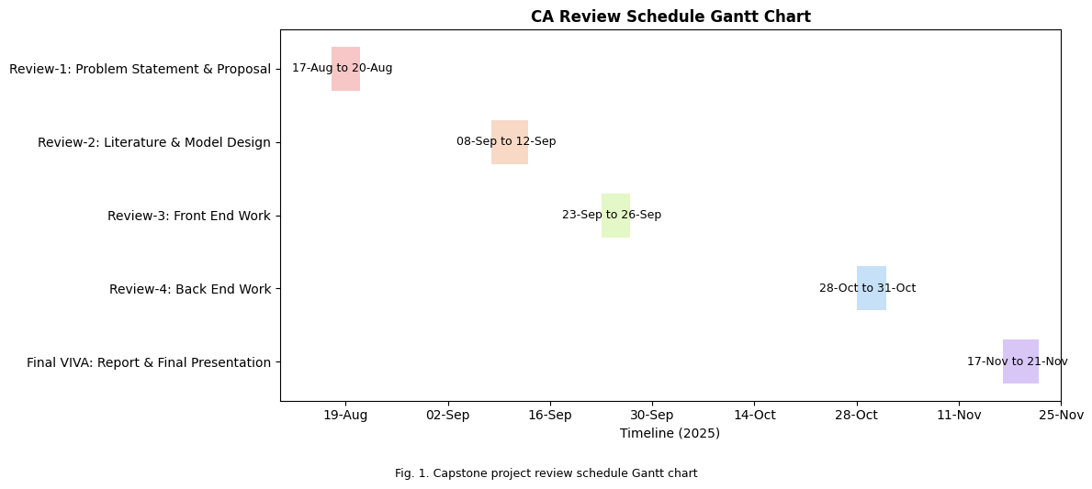
Timeline of the Project (Gantt Chart)

Slide 12
References (IEEE Paper format)
[1]. J. Li, K. Chen, and M. Singh, “BLIP — Bootstrapping Language-Image Pre-training,” Proceedings of Machine Learning Research, 2022.
[2]. J. Li, K. Chen, and M. Singh, “BLIP-2 — Bootstrapping with Frozen Image Encoders & LLMs,” Proceedings of Machine Learning Research, arXiv, 2023.
[3]. J. Li, K. Chen, and M. Singh, “InstructBLIP — Instruction-tuning BLIP-2 for General-Purpose VLMs,” NeurIPS Proceedings, 2023.
[4]. Z. Wang, X. Liu, and Y. Zhang, “MiniGPT-4: Practical Recipe for Conversational Multimodal Alignment,” arXiv, 2023.
[5]. H. Liu, J. Chen, and M. Zhou, “LLaVA — Large Language and Vision Assistant,” arXiv, 2023.
[6]. A. Radford, J. Kim, C. Hallacy et al., “CLIP: Learning Transferable Visual Models From Natural Language Supervision,” Proceedings of Machine Learning Research, 2021.
[7]. J. Jocher, A. Stoken, and Y. Wang, “YOLOv8: Real-Time Object Detection,” Ultralytics Docs / GitHub, 2023.
[8]. N. Carion, F. Massa, G. Synnaeve et al., “DETR: End-to-End Object Detection with Transformers,” 2020.
[9]. X. Zhu, W. Su, L. Lu et al., “Deformable DETR: Deformable Transformers for End-to-End Object Detection,” 2020.
[10]. A. Antol, A. Agrawal, J. Lu et al., “VQA: Visual Question Answering,” IEEE International Conference on Computer Vision (ICCV), 2017, pp. 2425–2433.
[11]. D. Hudson and C. Manning, “GQA: A New Dataset for Real-World Visual Reasoning and Compositional Question Answering,” CVPR, 2019, pp. 6700–6709.
[12]. J. Li, X. Su, and M. Bansal, “ALBEF / ViLT / LXMERT: Cross-Modality Transformer Approaches for Vision-Language Fusion,” 2019–2021.

Slide 13


